Slide 1



Global Superstore (Sales Distribution Report) - Vishnu Vijay
View in Power BI
Last data refresh:
12/9/2023 6:57:13 AM UTC
Downloaded at:
12/9/2023 8:28:03 AM UTC

Slide 2
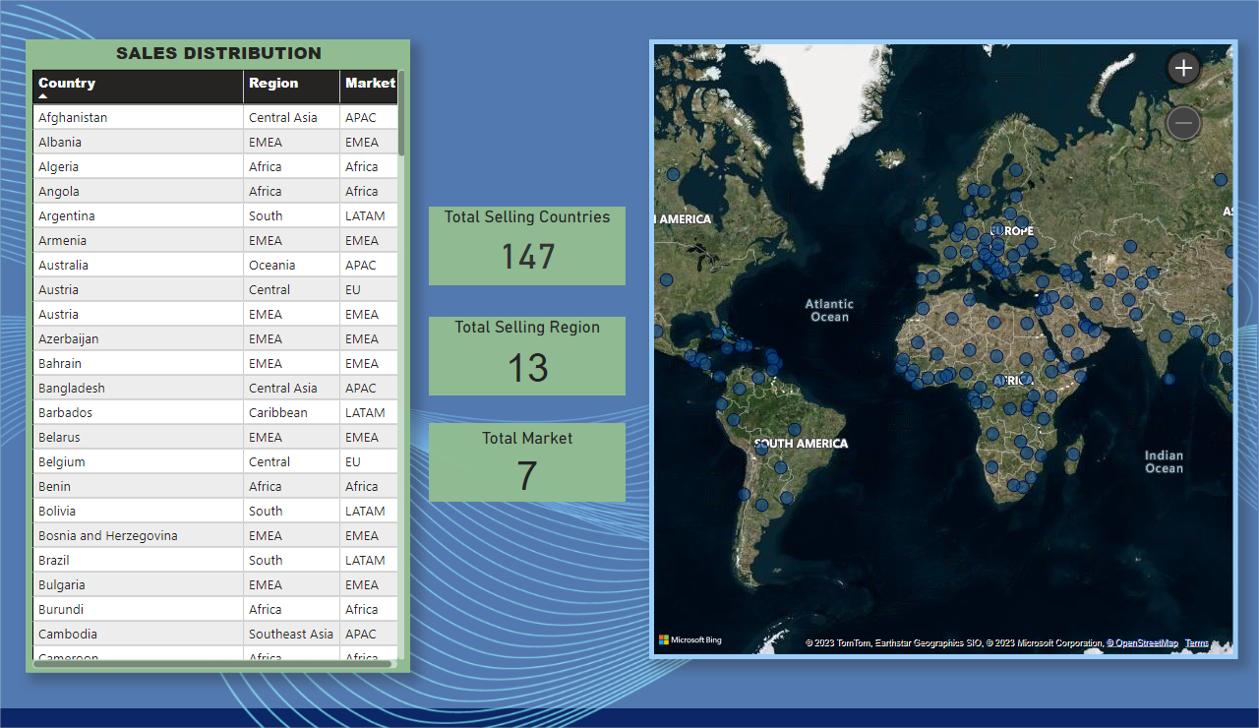
Sales Distribution
Notes:
SALES DISTRIBUTION
No alt text provided
Total Selling Countries
No alt text provided
map
No alt text provided
Total Selling Region
No alt text provided
Total Market
No alt text provided

Slide 3
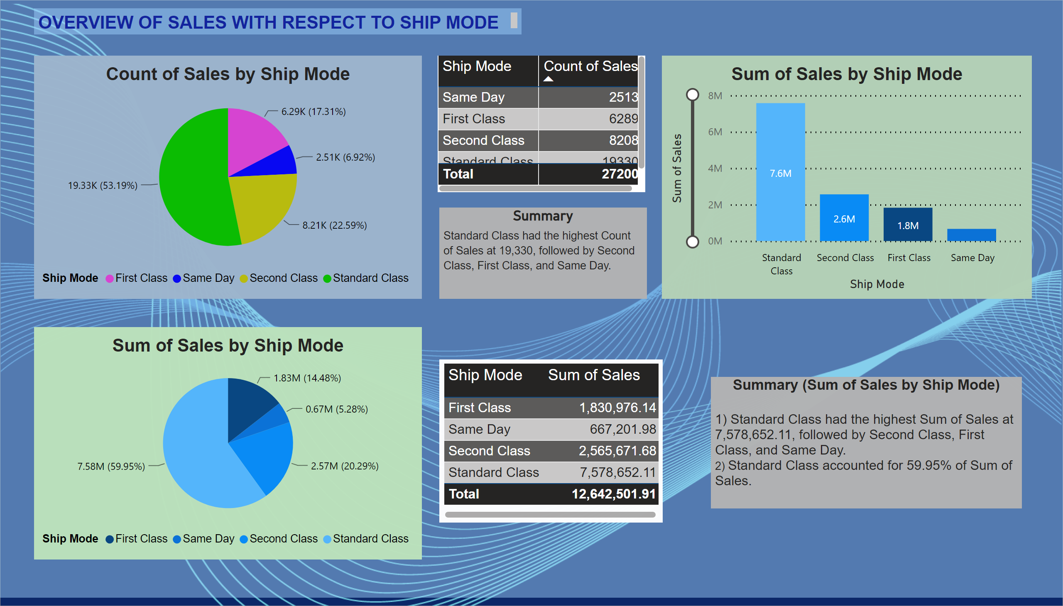
Sales by Ship Mode
Notes:
pieChart
No alt text provided
Sum of Sales by Ship Mode
No alt text provided
tableEx
No alt text provided
pieChart
No alt text provided
Summary (Sum of Sales by Ship Mode)
No alt text provided
Summary
No alt text provided
tableEx
No alt text provided
textbox
No alt text provided

Slide 4
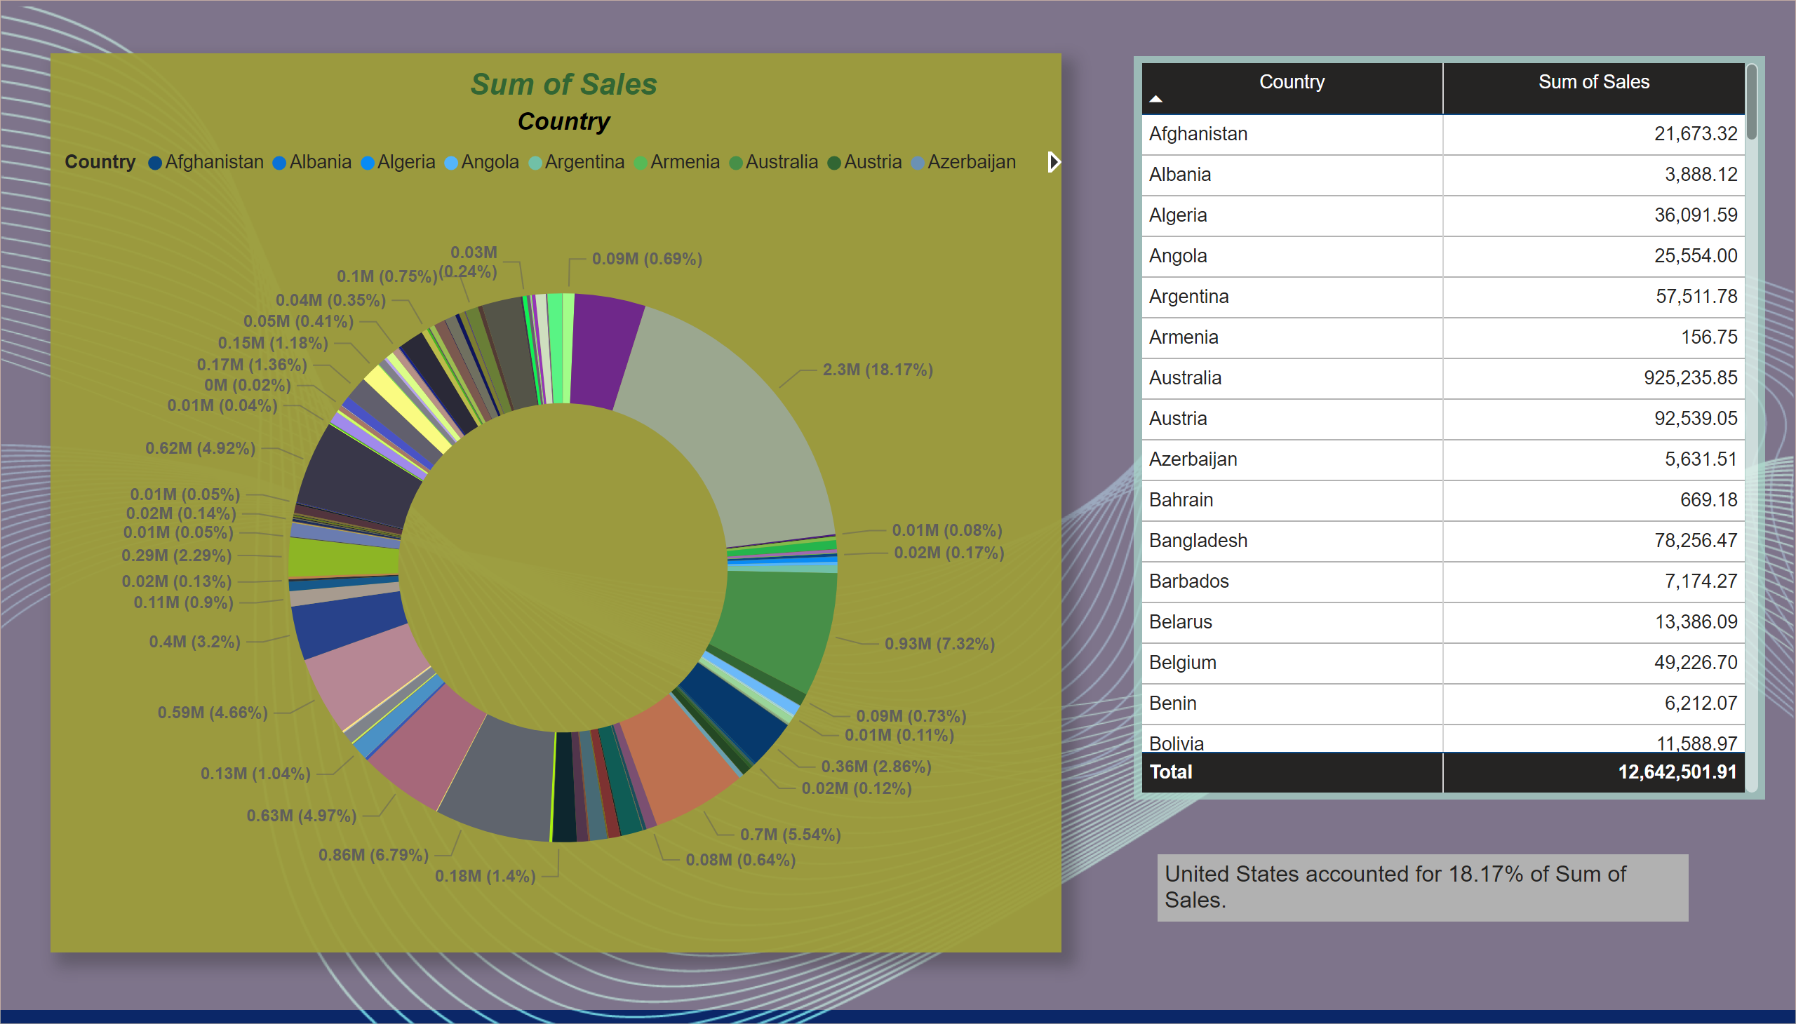
Sales by Country
Notes:
Sum of Sales
No alt text provided
textbox
No alt text provided
tableEx
No alt text provided

Slide 5
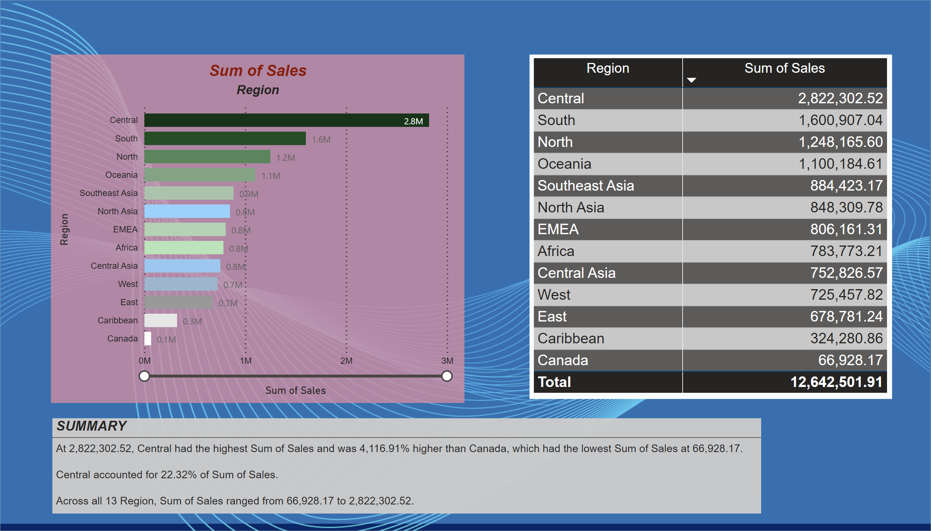
Sales by Region
Notes:
Sum of Sales
No alt text provided
SUMMARY
No alt text provided
tableEx
No alt text provided

Slide 6
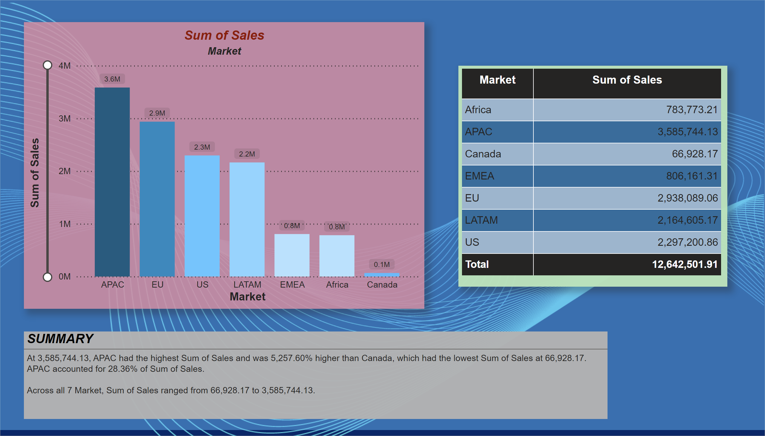
Sales by Market
Notes:
Sum of Sales
No alt text provided
SUMMARY
No alt text provided
tableEx
No alt text provided

Slide 7
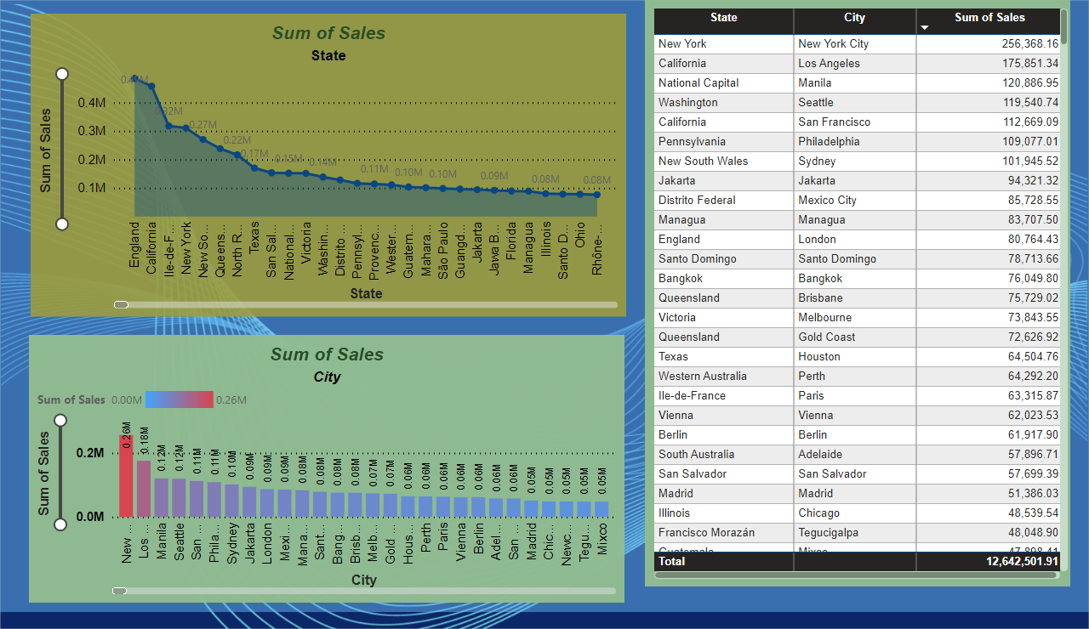
Sales by City/State
Notes:
Sum of Sales
No alt text provided
Sum of Sales
No alt text provided
tableEx
No alt text provided

